Slide 1

2024
Speedbump Detection
and Distance Measurement
Speedbump Detection and Distance Measurement ensures autonomous vehicles detect speed bumps and adjust speed for smooth, safe navigation.
·

Slide 2
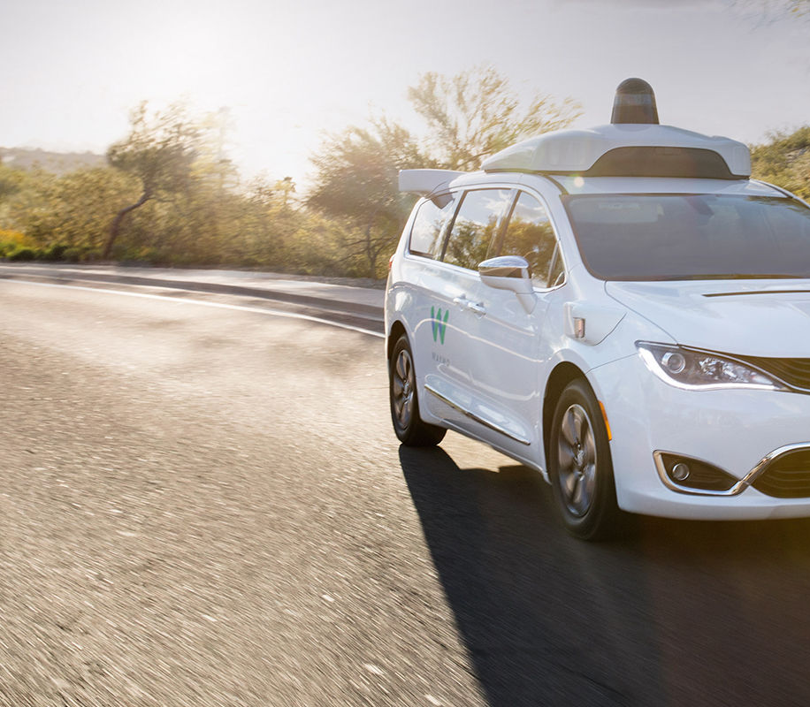
Background
The significance of driverless vehicles
Driverless technology is becoming increasingly mature in the fields of transportation and logistics, which can improve transportation efficiency, reduce traffic accidents, and promote the intelligent development of the transportation system.
Specific issues related to speed bumps
For automated driving, the detection of speed bumps and the measurement of the distance to them are crucial to avoid the vehicle suffering from impacts or affecting driving stability due to failure to react in time.
1
2
3
Challenges in Current Scenarios
There are many types of speed bumps, road conditions are complex, and factors such as weather and light increase the difficulty of detection. How to accurately recognize speed bumps and calculate the distance in these environments is the main challenge facing the system.
Notes:
随着自动驾驶的兴起，减速带的检测可以避免产生一些行驶问题。

Slide 3
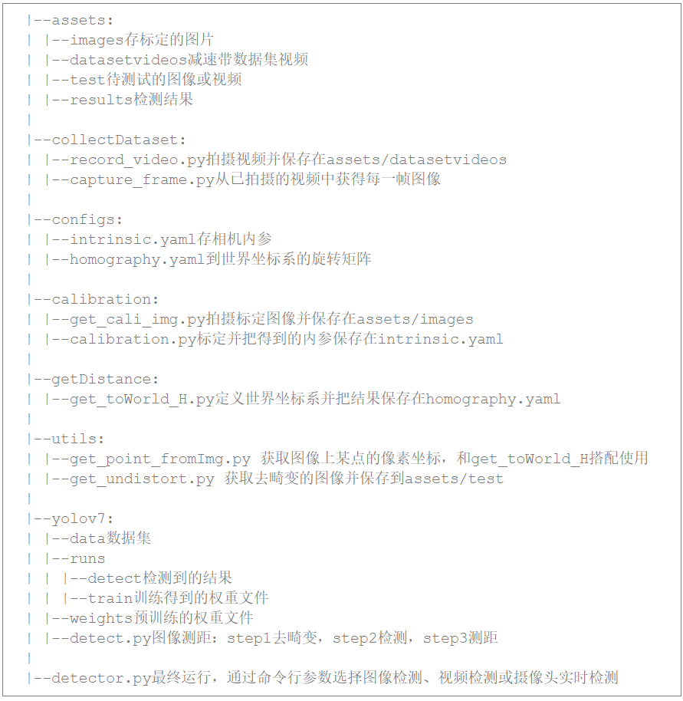
System structure design
Camera Calibration
Data Acquisition
take pictures
labeling data by labelImg
create dataset
Target Detection
YOLOv7 model
training on autodl (with cuda): 300epochs
Get Homography
define world coordinate
Pixel-to-World Correspondence
Distance Measure
Notes:
这张图是我们的代码框架，每个文件夹都代表一系列步骤。我们主要的流程

Slide 4
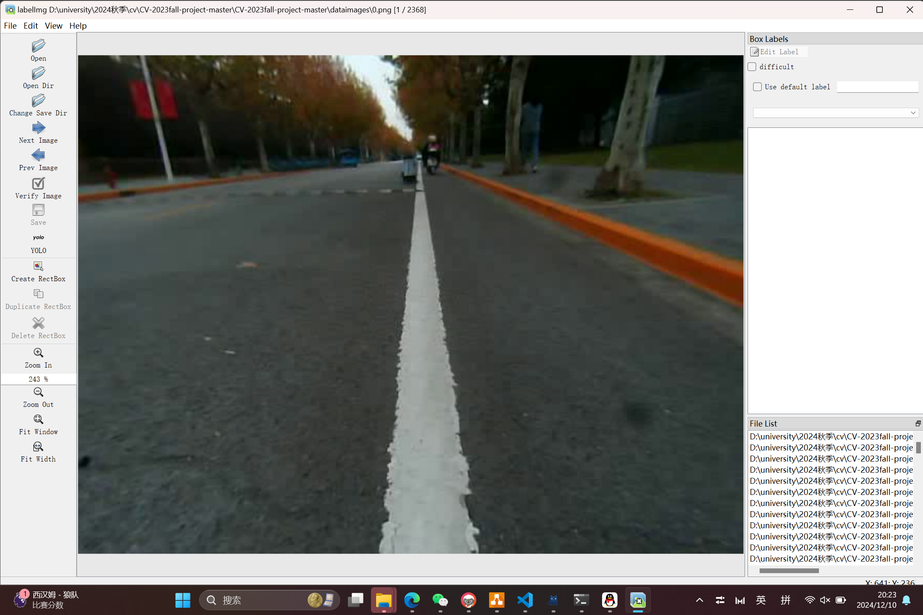
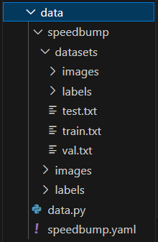
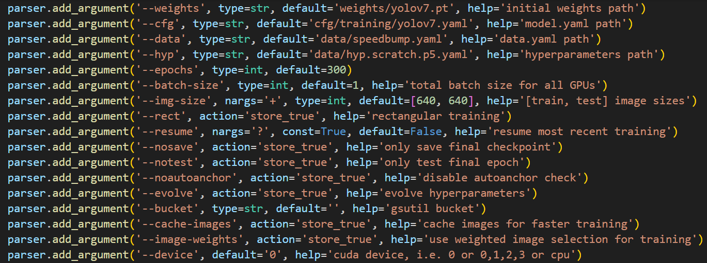
Key Algorithm - Train model
YOLOv7 for speed bump detection
YOLOv7 uses a deep convolutional neural network to extract image features through multiple convolutional layers, combined with an improved loss function and anchor box, which significantly improves the detection of small objects.
Notes:
接下来讲一下主要算法。我们选择的yolov7，它通过深度学习提取图像特征，最后会在画面上展示物体的锚点框。首先我们下载了yolov7的代码框架

Slide 5
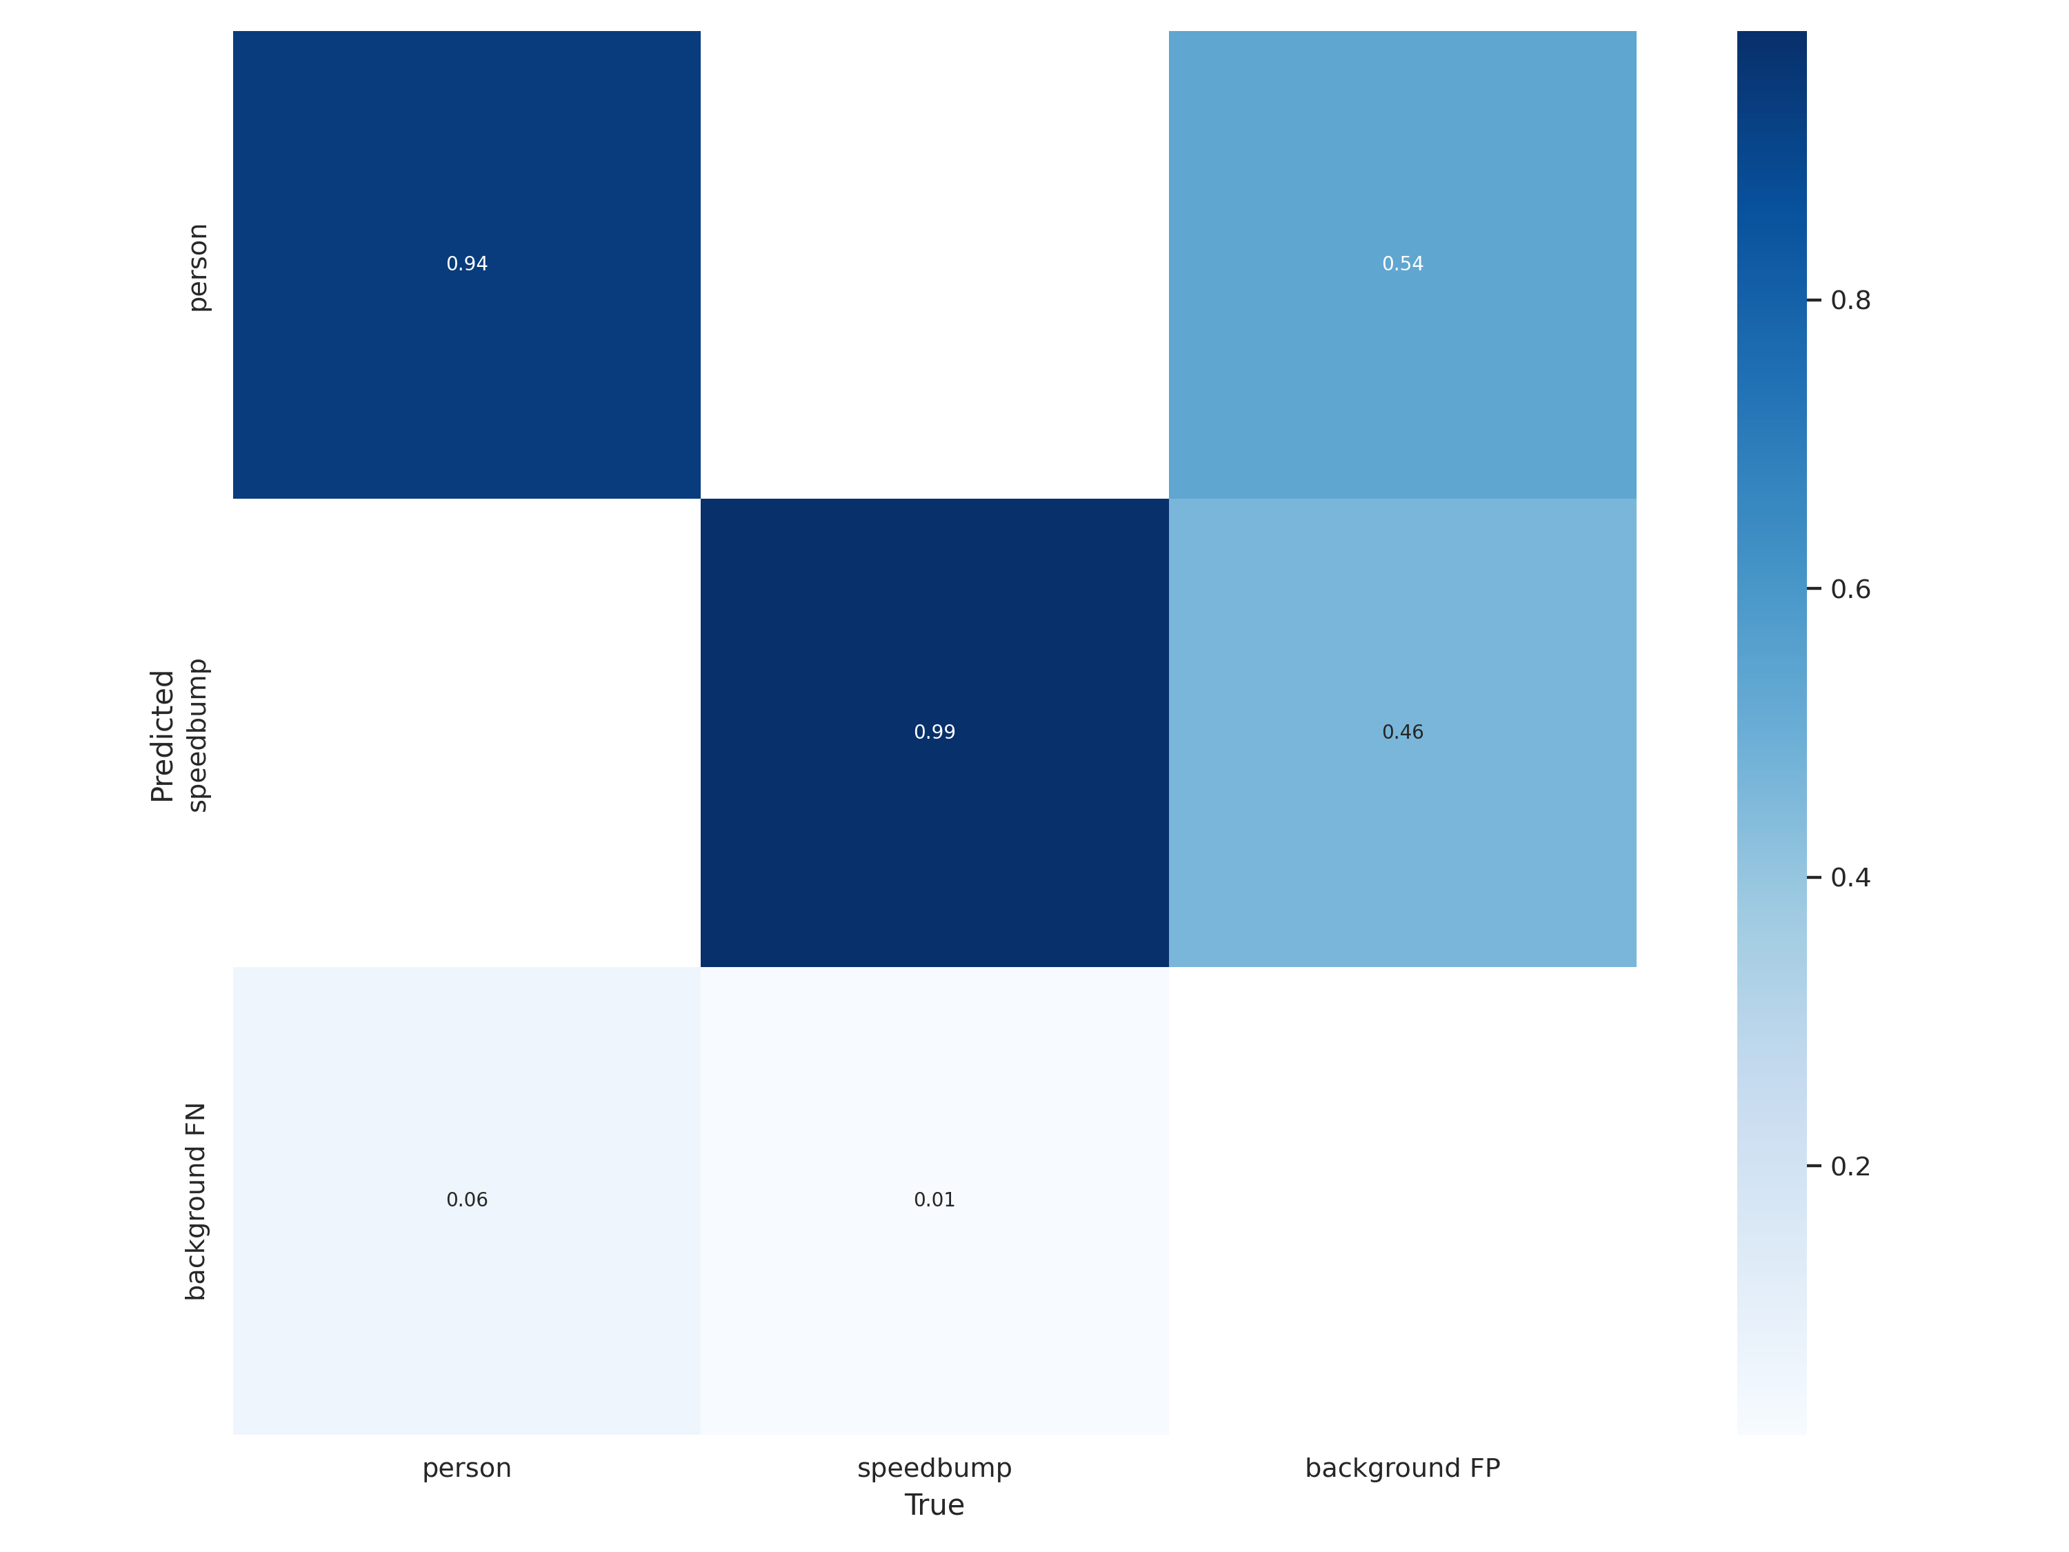
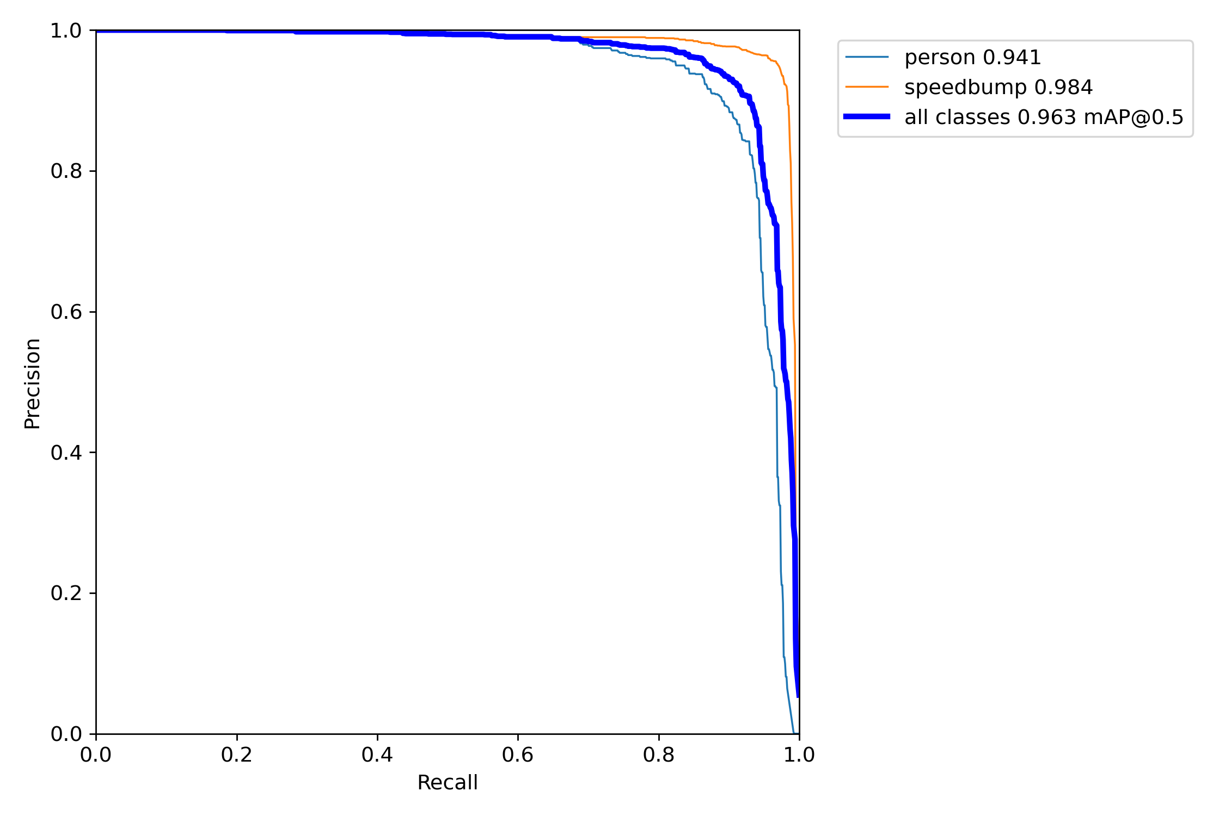
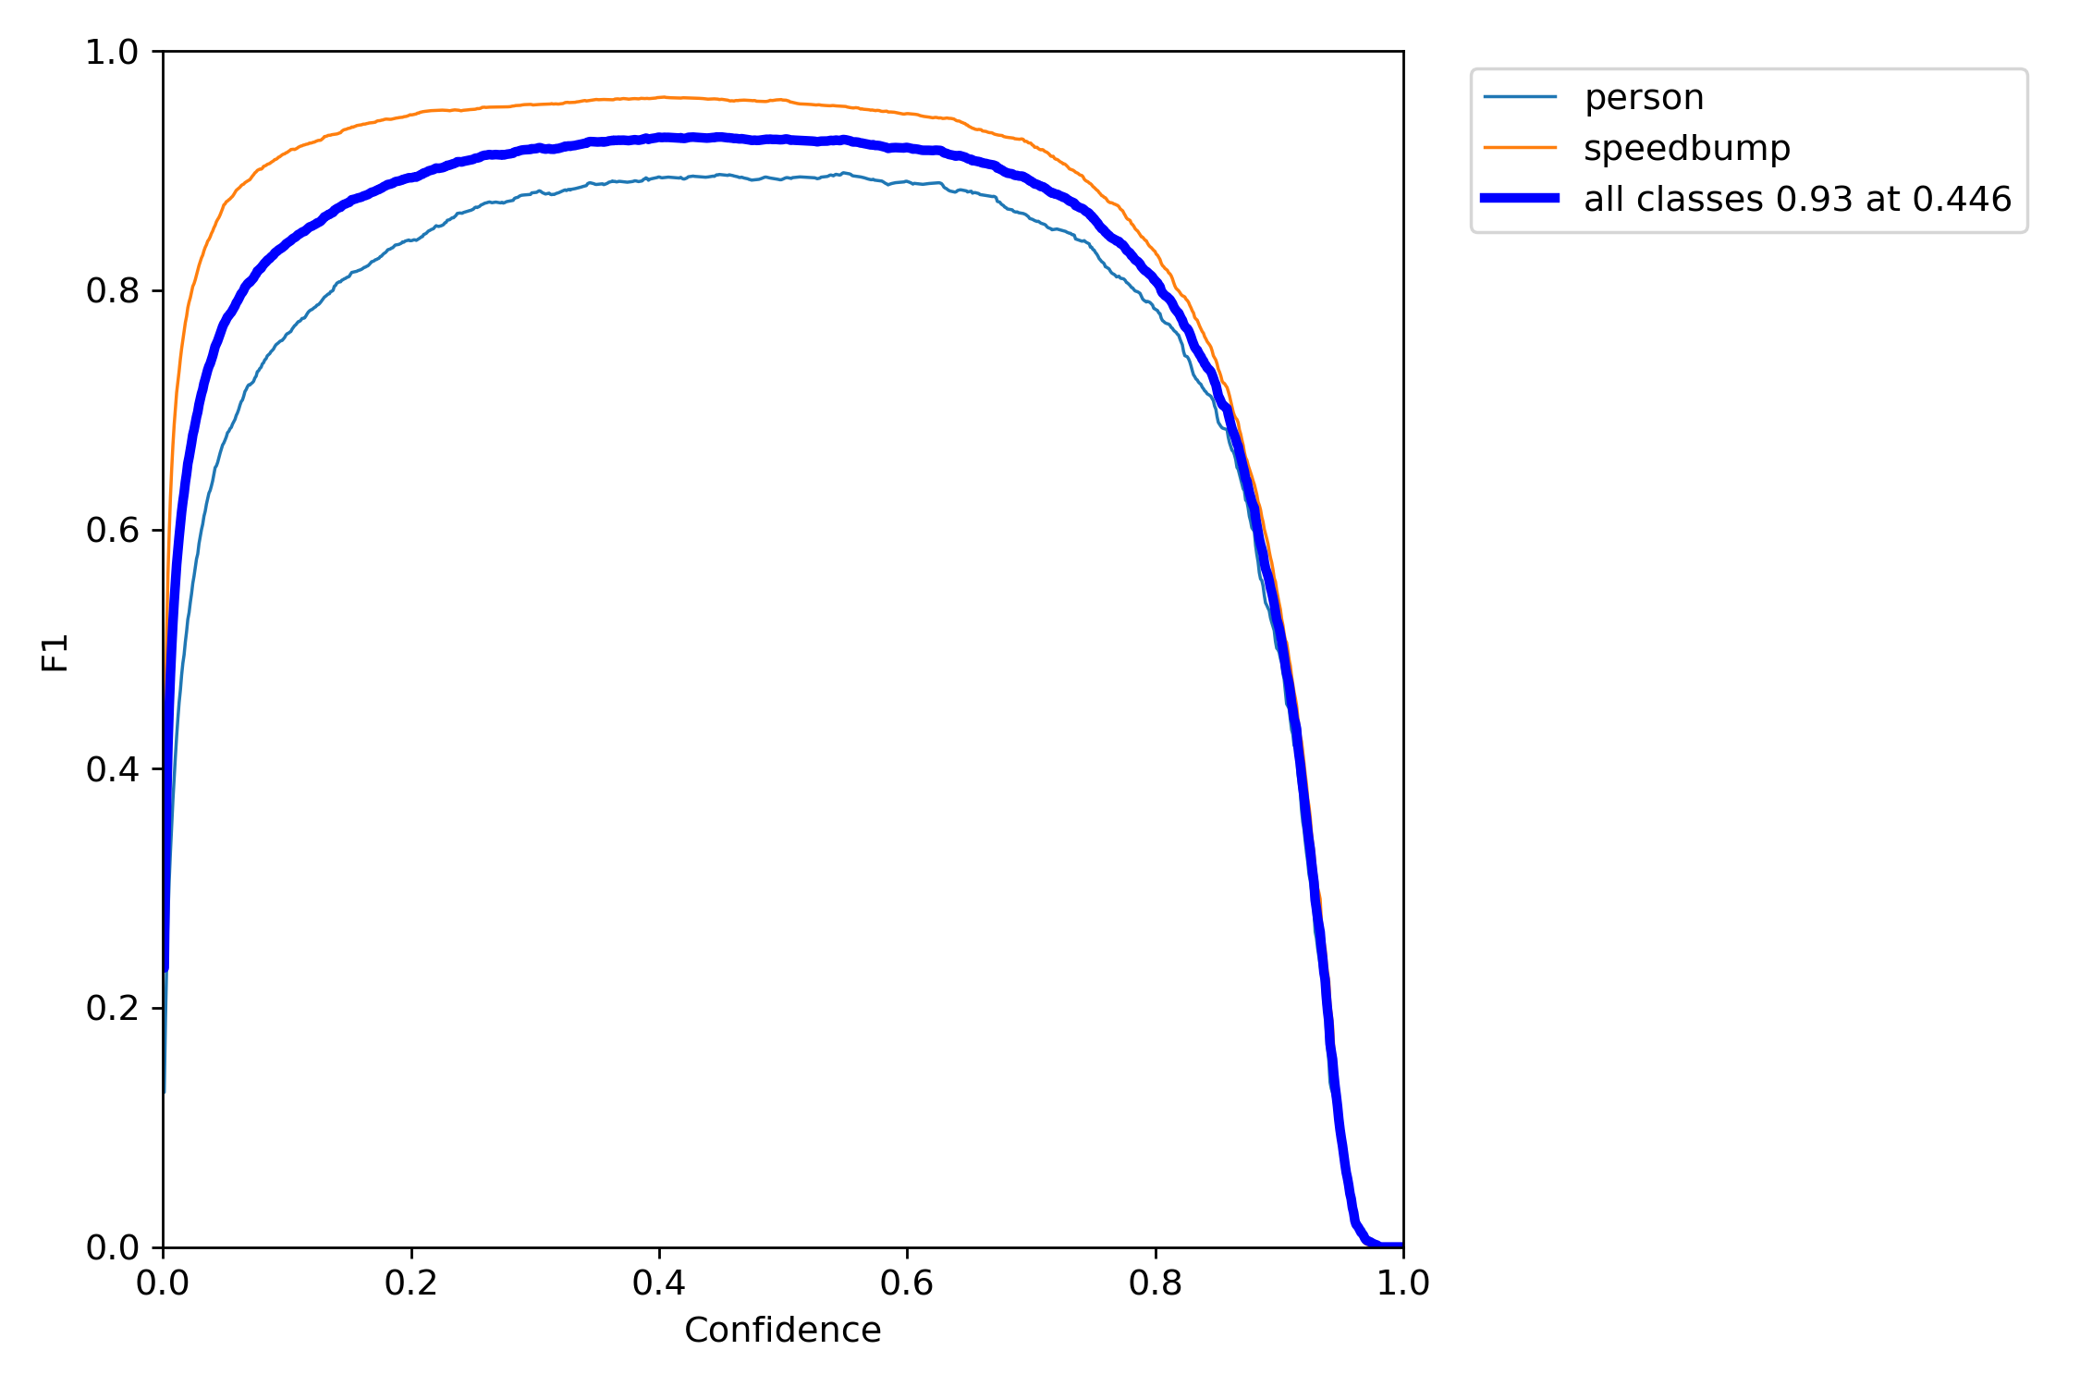
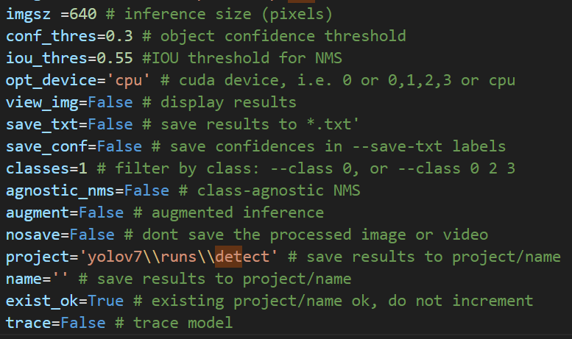
Key Algorithm - Train model
Notes:
接下来是模型的评估。混淆矩阵

Slide 6
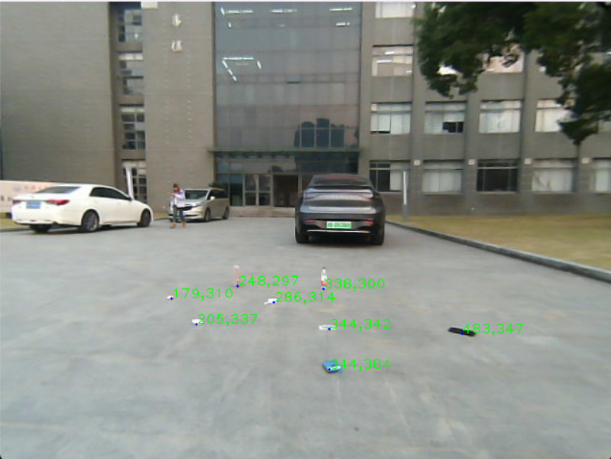
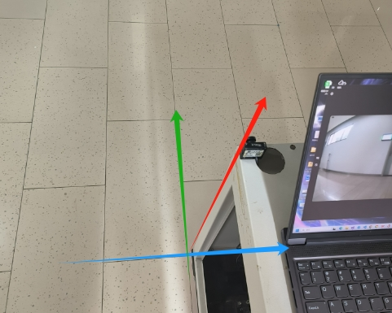
Key Algorithm - Determine the homography matrix
get_point_fromImg.py ：Determine the pixel coordinates of the object
get_toWorld_H.py ：
Measure the object in the world coordinate system
Calculate the H via cv2.findHomography(imagePoints, worldPoints)
click a point to get the coordinate
Notes:
接下来是测量变换矩阵。我们的坐标系这样定义。我们测量了这个瓷砖的长宽，以此确定一些预先选定的点的世界坐标。然后通过这个程序获取相应点的像素坐标。

Slide 7
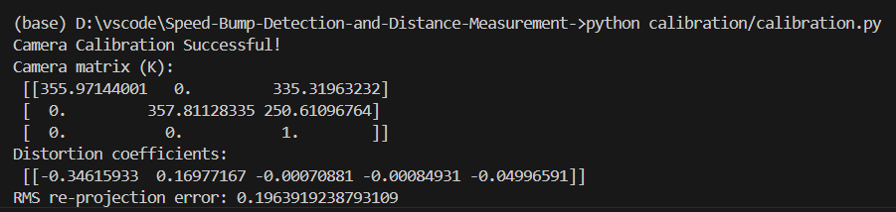
Key Algorithm - Distance Estimation
stream
image
step1
undistortion
step2
object detection
step3
distance measurement
show()
intrinsic by calibration
load model:
yolo weight file
1. feature extraction: center coordinates
2. convert to world coordinates by H
3. get distance: return the y
Notes:
首先获取减速带的位置。检测程序会返回锚点框的坐标，

Slide 8

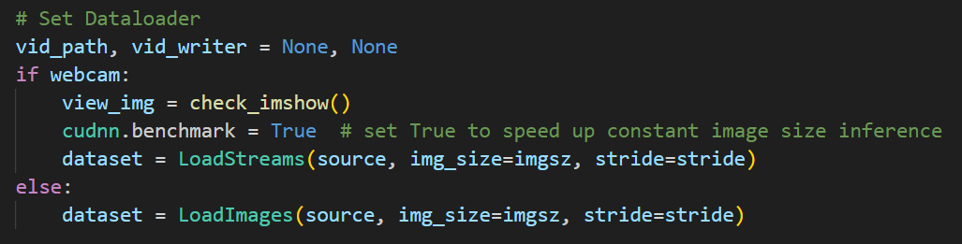


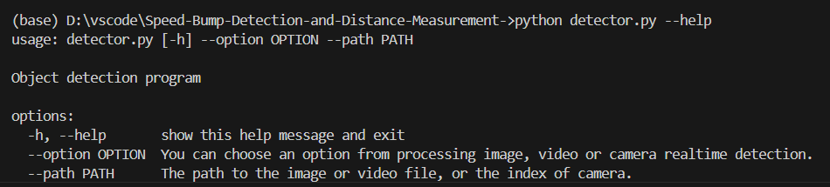
Key Algorithm - User interface
ArgumentParser
Notes:
最后讲一下用户怎么使用

Slide 9
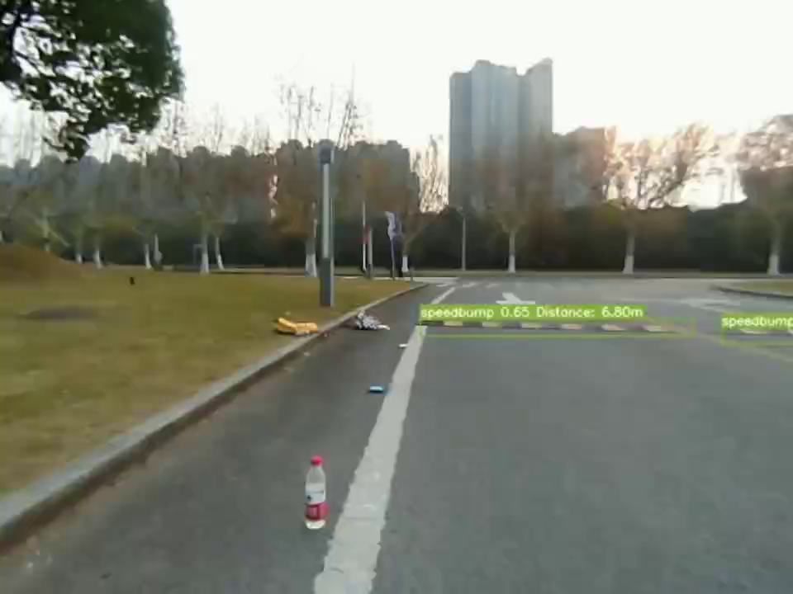
Experimental Result
Error analysis
Calibration: low-quality sample images may affect the camera's projection model and transformation matrix calculation.
Environment: Due to the uneven road surface, camera vibrations during vehicle movement affect distance calculation accuracy.
Camera: The images captured by the camera are blurry, leading to inaccurate extraction of feature points’ pixel coordinates.
Use image enhancement techniques (such as de-blurring) to improve the accuracy of feature point extraction.
Introduce depth estimation or multi-camera vision to further enhance distance calculation accuracy.

Slide 10
References
Wang, C.-Y., Bochkovskiy, A., & Liao, H.-Y. M. (2022). YOLOv7: Trainable bag-of-freebies sets new state-of-the-art for real-time object detectors. arXiv preprint arXiv:2207.02696. https://doi.org/10.48550/arXiv.2207.02696
We used the code framework of this YOLO model for model training and detection

